Slide 1
Student Admission Data
Amol Crasta
Mangalore
14-01-2025

Slide 2
Problem Statement
Understand student admission patterns using historical data.
Identify factors influencing admission decisions.
Support academic and business decision-making.

Slide 3
Data Set Description
This dataset provides a comprehensive and realistic representation of the college admission landscape in India.
Includes information about students from 26 different Indian states, spanning diverse academic backgrounds and career aspirations.
The dataset contains a wide range of variables such as demographics, preferred streams, entrance exams (JEE, NEET, CET), Class 12 board performance, extracurricular involvement, admission probability, and final decision.
The dataset is synthetically generated but modeled to resemble real patterns observed in Indian admissions.

Slide 4
Data Cleaning

Slide 5
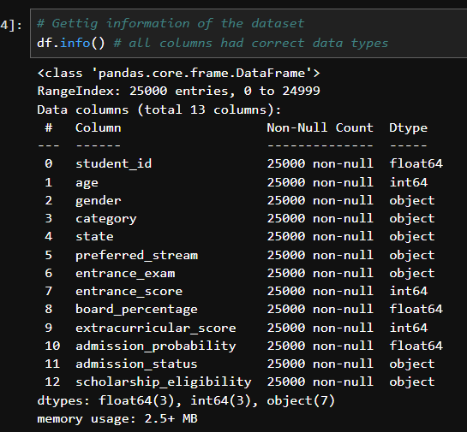
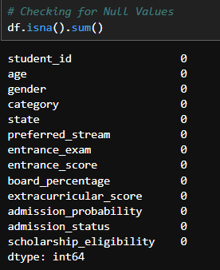
Initial Data Inspection
Used df.info() to check data types and null values.
Verified dataset structure and column consistency.
Ensured readiness for cleaning and analysis.
There was no missing data and null Values.
Suggestion: Category , State , Preferred Stream(based on entrance exam, scholarship), admission status(based on admission probability, entrance exam(based on State) can be best to fill using mode.
Entrance Score(based on entrance exam),board percentage( based on state),extracurricular score(based on board percentage) can be best filled using mean.

Slide 6
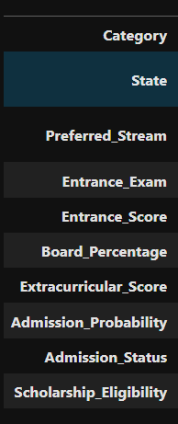
Required Column Headers
0 student_id – not required
1 age - not required
2 gender - not required
3 category – required
4 state - required
5 preferred_stream - required
6 entrance_exam - required
7 entrance_score - required
8 board_percentage - required
extracurricular_score - required
admission_probability - required
11 admission_status - required
12 scholarship_eligibility - required

Slide 7
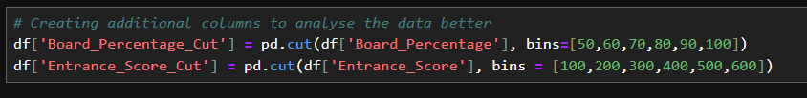
Additional Columns required for Visualisation
Additional requirement – 2 columns
Cutoff of board percentage
Cutoff of Entrance score
Bin width of range 10 for board percentage
Bin width of range 100 for Entrance score

Slide 8
Visualizations

Slide 9
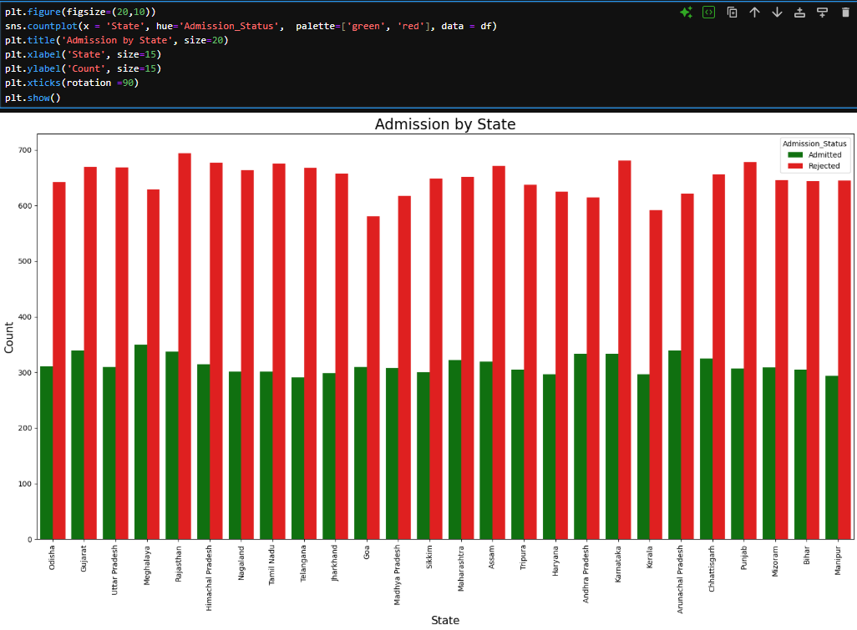
Admission status per State
The graph shows number of students from each state, split by Admitted vs Not Admitted.
Certain states have
a. More applicants
b. Better academic preparation
c. Higher awareness of the institution
States with higher applicant quality will continue to dominate admissions.
Suggestions:
Increase outreach and awareness in low-admission states.
Analyze state-wise academic support or eligibility gaps.

Slide 10
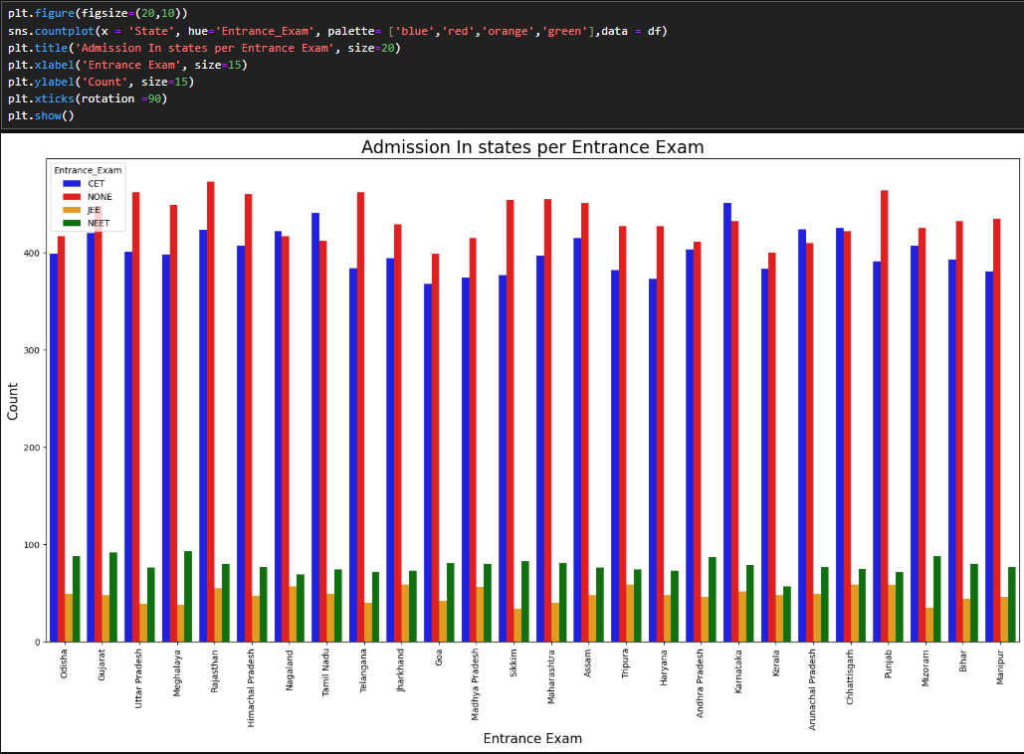
State VS entrance exam participation
Students from different states prefer or appear for different entrance exams.
Entrance exam popularity varies by region.
Coaching availability and exam awareness differ state-wise.
States aligned with popular exams will have better admission chances.
Suggestions:
Accept multiple entrance exams fairly.
Normalizing scores across exams.

Slide 11
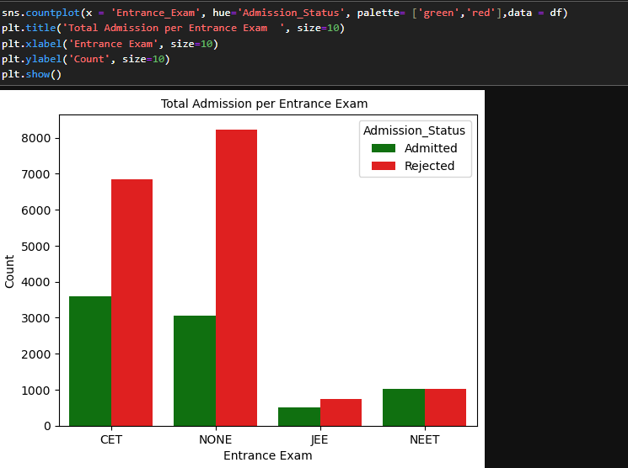
Entrance exam vs admission status
CET entrance exams show higher admission success rates.
JEE and NEET are better aligned with admission criteria
They are more competitive.
Students will prefer exams with higher success rates.
Competition in those exams will increase.
Suggestions:
Regularly review exam weightage.
Avoid over-dependence on a single exam.

Slide 12
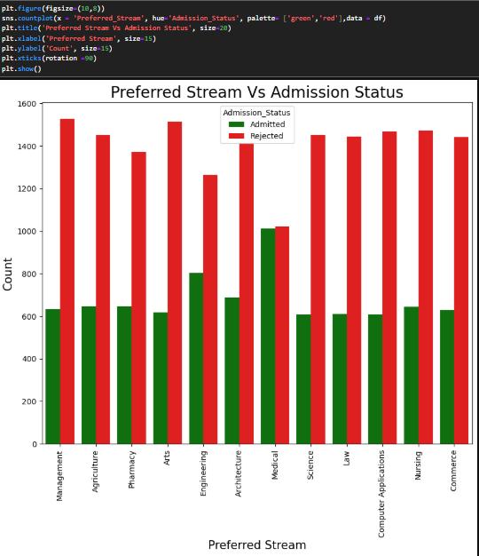
Preferred stream vs admission status
Some streams have more admitted students than others.
Popular streams have:
a. More seats
b. Higher demand
Some streams are more selective.
Popular streams will remain competitive.
Less popular seats will have seat vacancies.
Suggestions:
Balance seat allocation.
Promote lesser-known streams with strong career outcomes.

Slide 13
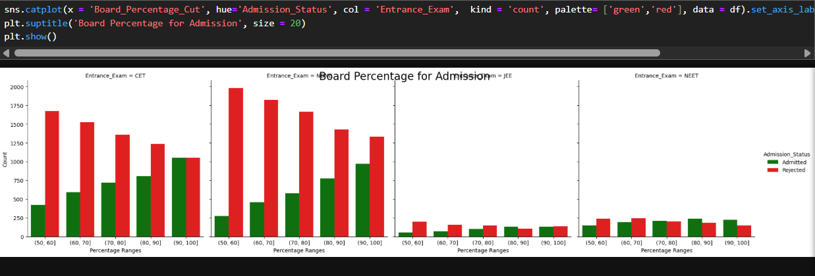
Board percentage cut vs admission status
Higher board percentage ranges show more admissions.
Board percentage is a key eligibility criterion.
Higher scores indicate better academic readiness.
Cut-offs may increase over time.
Competition will intensify in top score brackets.
Suggestions:
Introduce flexibility near cut-off margins.
Consider percentile-based evaluation.

Slide 14
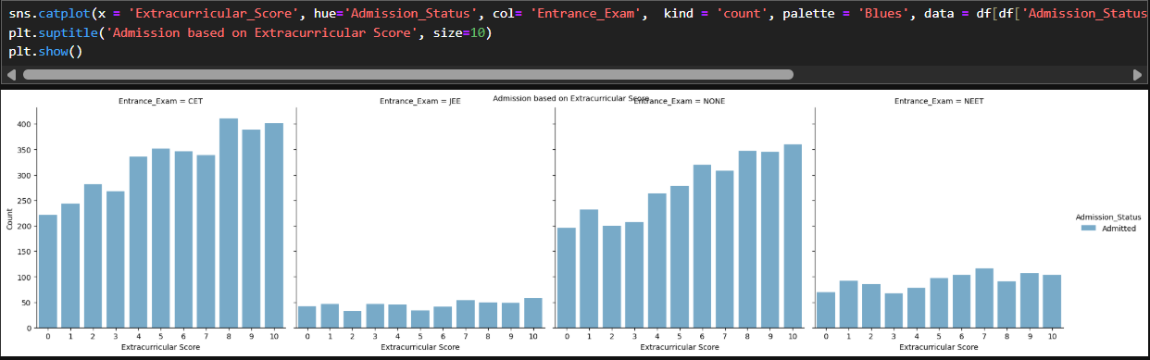
Extracurricular score vs admission status(admission only)
Students with higher extracurricular scores have better admission chances.
Institutions value holistic development, not just academics.
Extracurriculars will gain more importance.
Students will focus on all-round profiles.
Suggestions:
Clearly define extracurricular weightage.
Standardize scoring to avoid subjectivity.

Slide 15
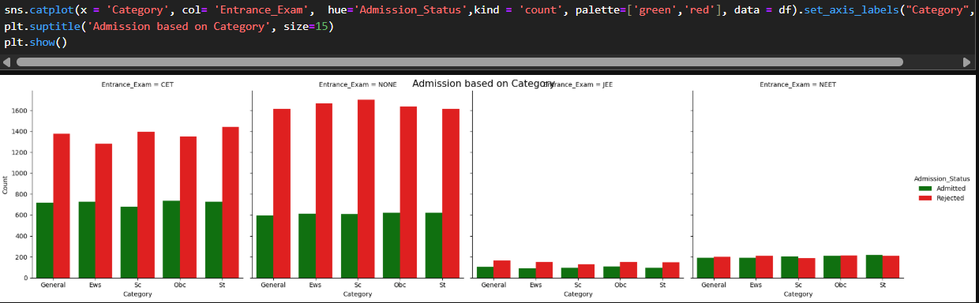
Category VS entrance exam vs admission status
Admission outcomes vary by category and entrance exam combination.
Reservation policies and exam difficulty differ.
Category-based cut-offs influence results.
Admission patterns will remain structured by policy.
Certain category–exam combinations will dominate.
Suggestions:
Monitor fairness across categories.
Periodically review category-based criteria.

Slide 16
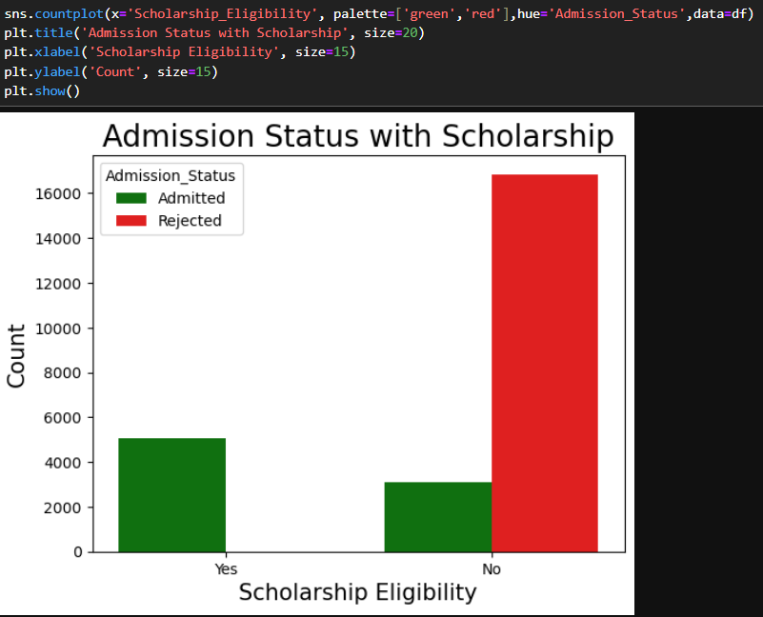
Scholarship eligibility vs admission status
Scholarship-eligible students show higher admission rates.
Scholarships attract strong candidates.
Financial support improves enrolment decisions.
Scholarships will continue to influence admissions positively.
Suggestions:
Expand scholarship programs.
Target high-potential but underprivileged students.

Slide 17
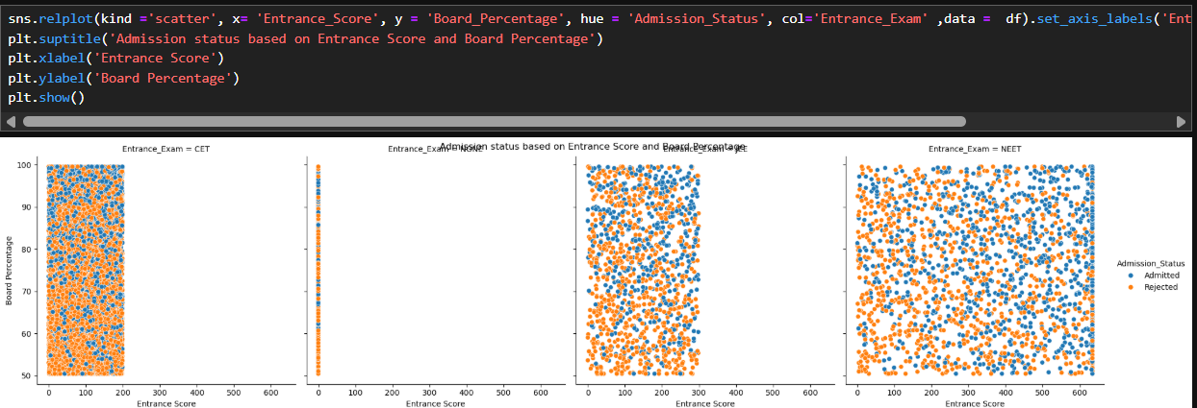
Exam Score vs board percentage
A positive relationship between entrance score and board percentage.
Strong academic students tend to perform well consistently.
These variables will remain strong predictors in models.
Suggestions:
Use both scores together for better evaluation.
Avoid relying on only one metric.

Slide 18
Feature Encoding

Slide 19
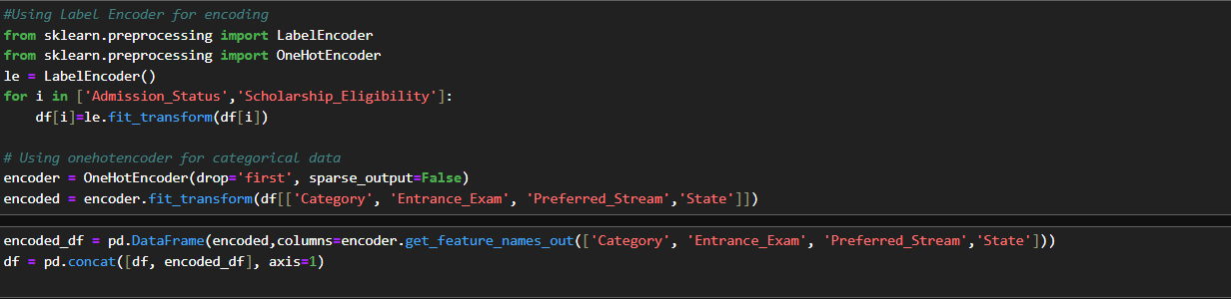
Encoding the dataset
Label Encoder for binary data. (Yes/No)
Admission Status, Scholarship Eligibility
One Hot Encoder for categorical features.
Entrance exam, Category, Preferred Stream

Slide 20
Machine Learning

Slide 21
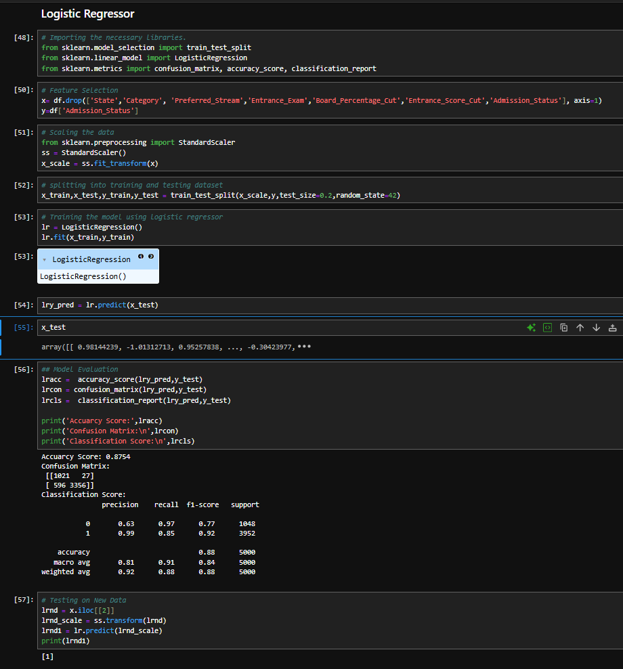
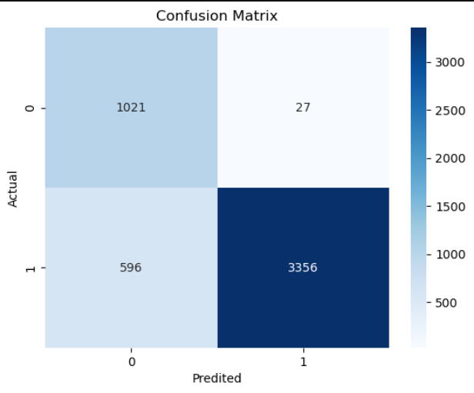
Logistic Regressor
Import the necessary libraries.
Feature Selection
Scaling the data
Splitting into training and testing dataset.
Training the model using logistic regressor.
Model Evaluation.
Testing on New Data

Slide 22
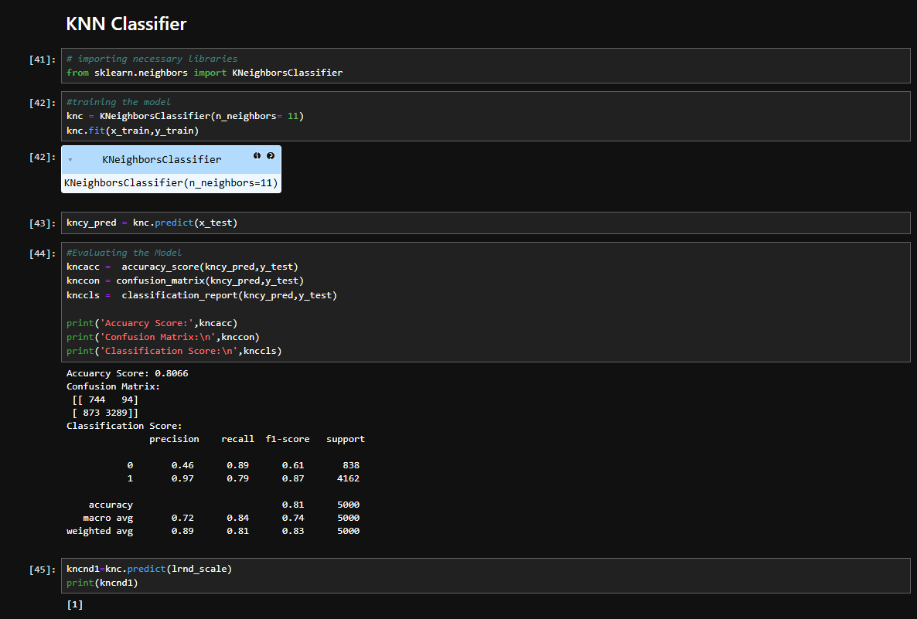
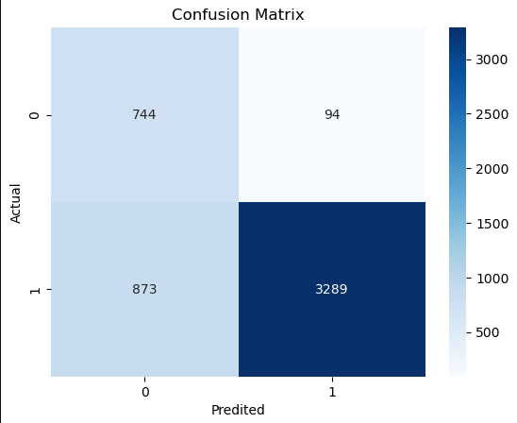
Knn classifier
Import the necessary libraries.
Feature Selection
Scaling the data
Splitting into training and testing dataset.
Training the model using logistic regressor.
Model Evaluation.
Testing on New Data

Slide 23
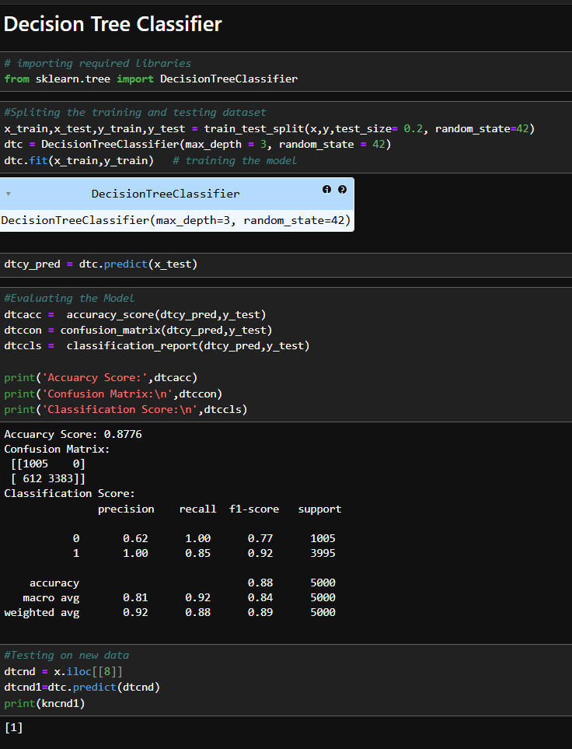
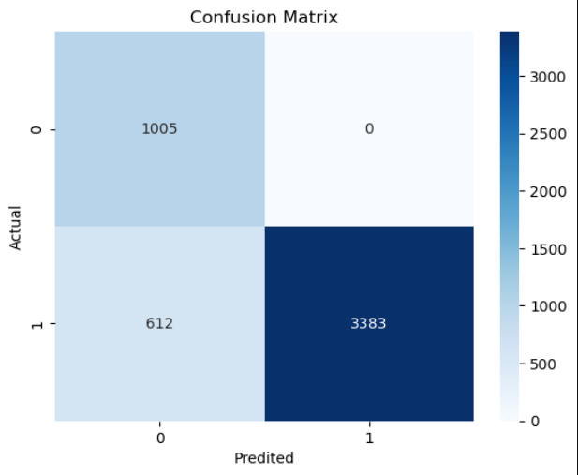
Decision tree Classifier
Import the necessary libraries.
Feature Selection
Scaling the data
Splitting into training and testing dataset.
Training the model using logistic regressor.
Model Evaluation.
Testing on New Data

Slide 24
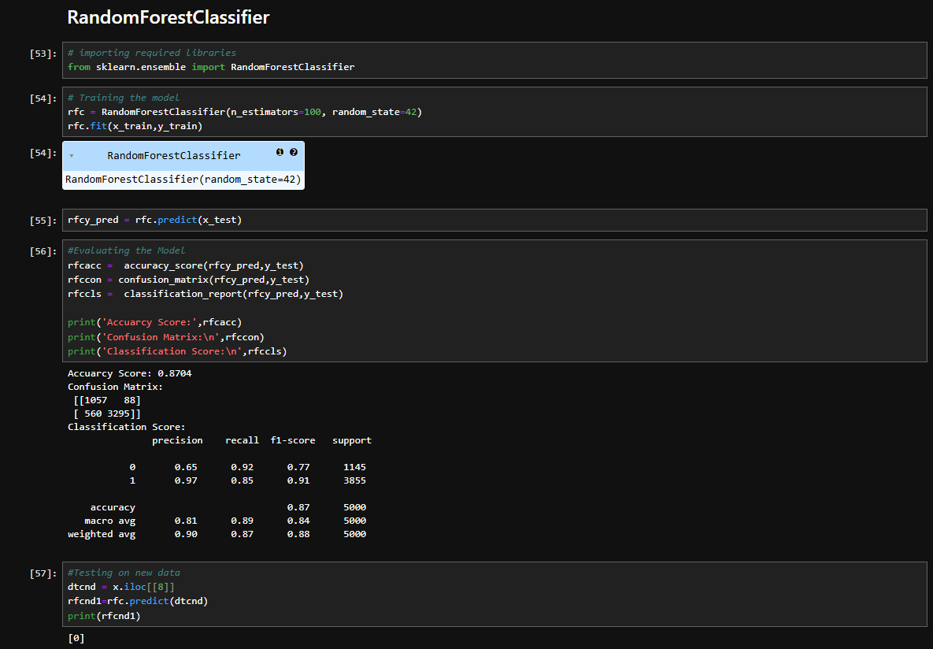
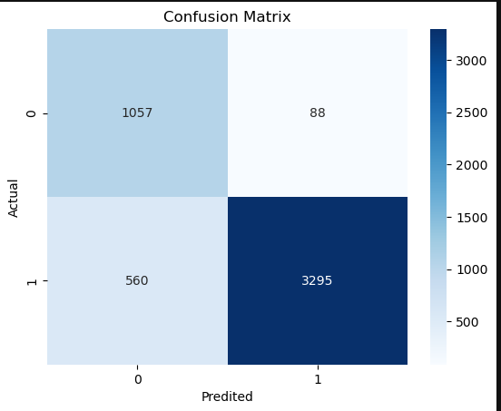
RANDOM FOREST Classifier
Import the necessary libraries.
Feature Selection
Scaling the data
Splitting into training and testing dataset.
Training the model using logistic regressor.
Model Evaluation.
Testing on New Data

Slide 25
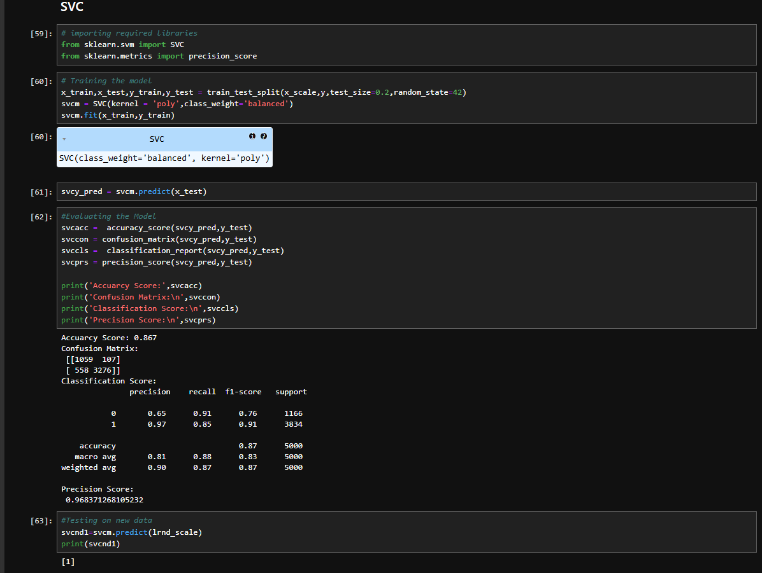

Support Vector Classifier
Import the necessary libraries.
Feature Selection
Scaling the data
Splitting into training and testing dataset.
Training the model using logistic regressor.
Model Evaluation.
Testing on New Data

Slide 26
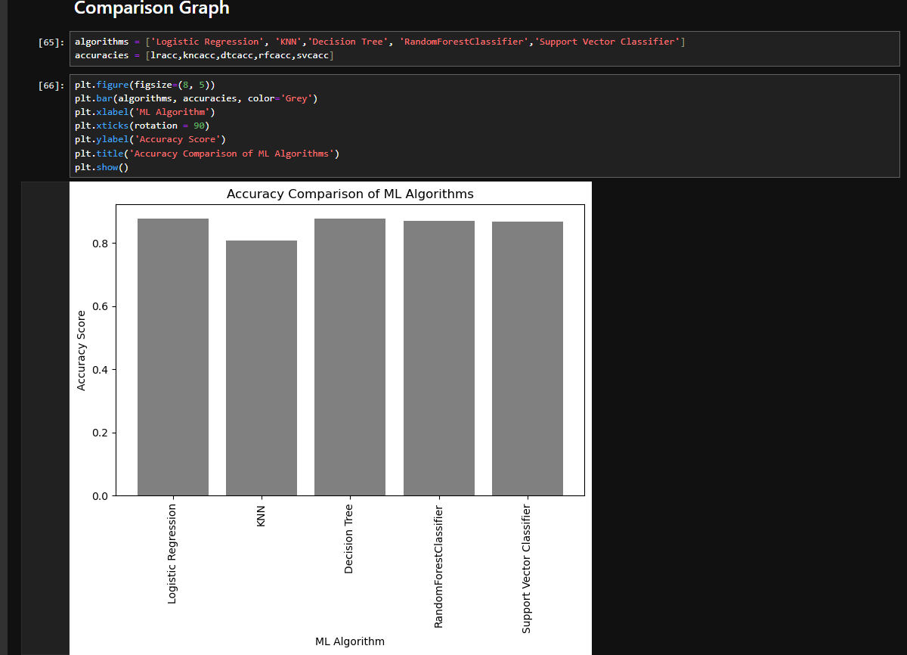
Comparison Graphs

Slide 27
Conclusion
Notebook steps followed a structured data analysis approach.
Insights can help institutions refine admission strategies.
Project demonstrates practical analytics application.

Slide 28
Thank YOu

